Slide 1
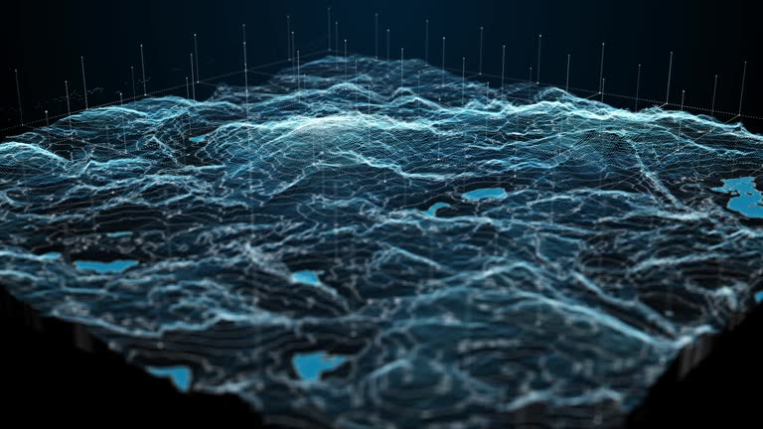

MINERAL INTELLIGENCE & EXPLORATION PLATFORM
Every layer of evidence, one ranked list of targets, and the paper trail to defend it.
32 features · seven groups · five platform systems · twelve integrated data sources
West Africa · Ghana
PLATFORM BRIEFING · AUGUST 2026

Slide 2
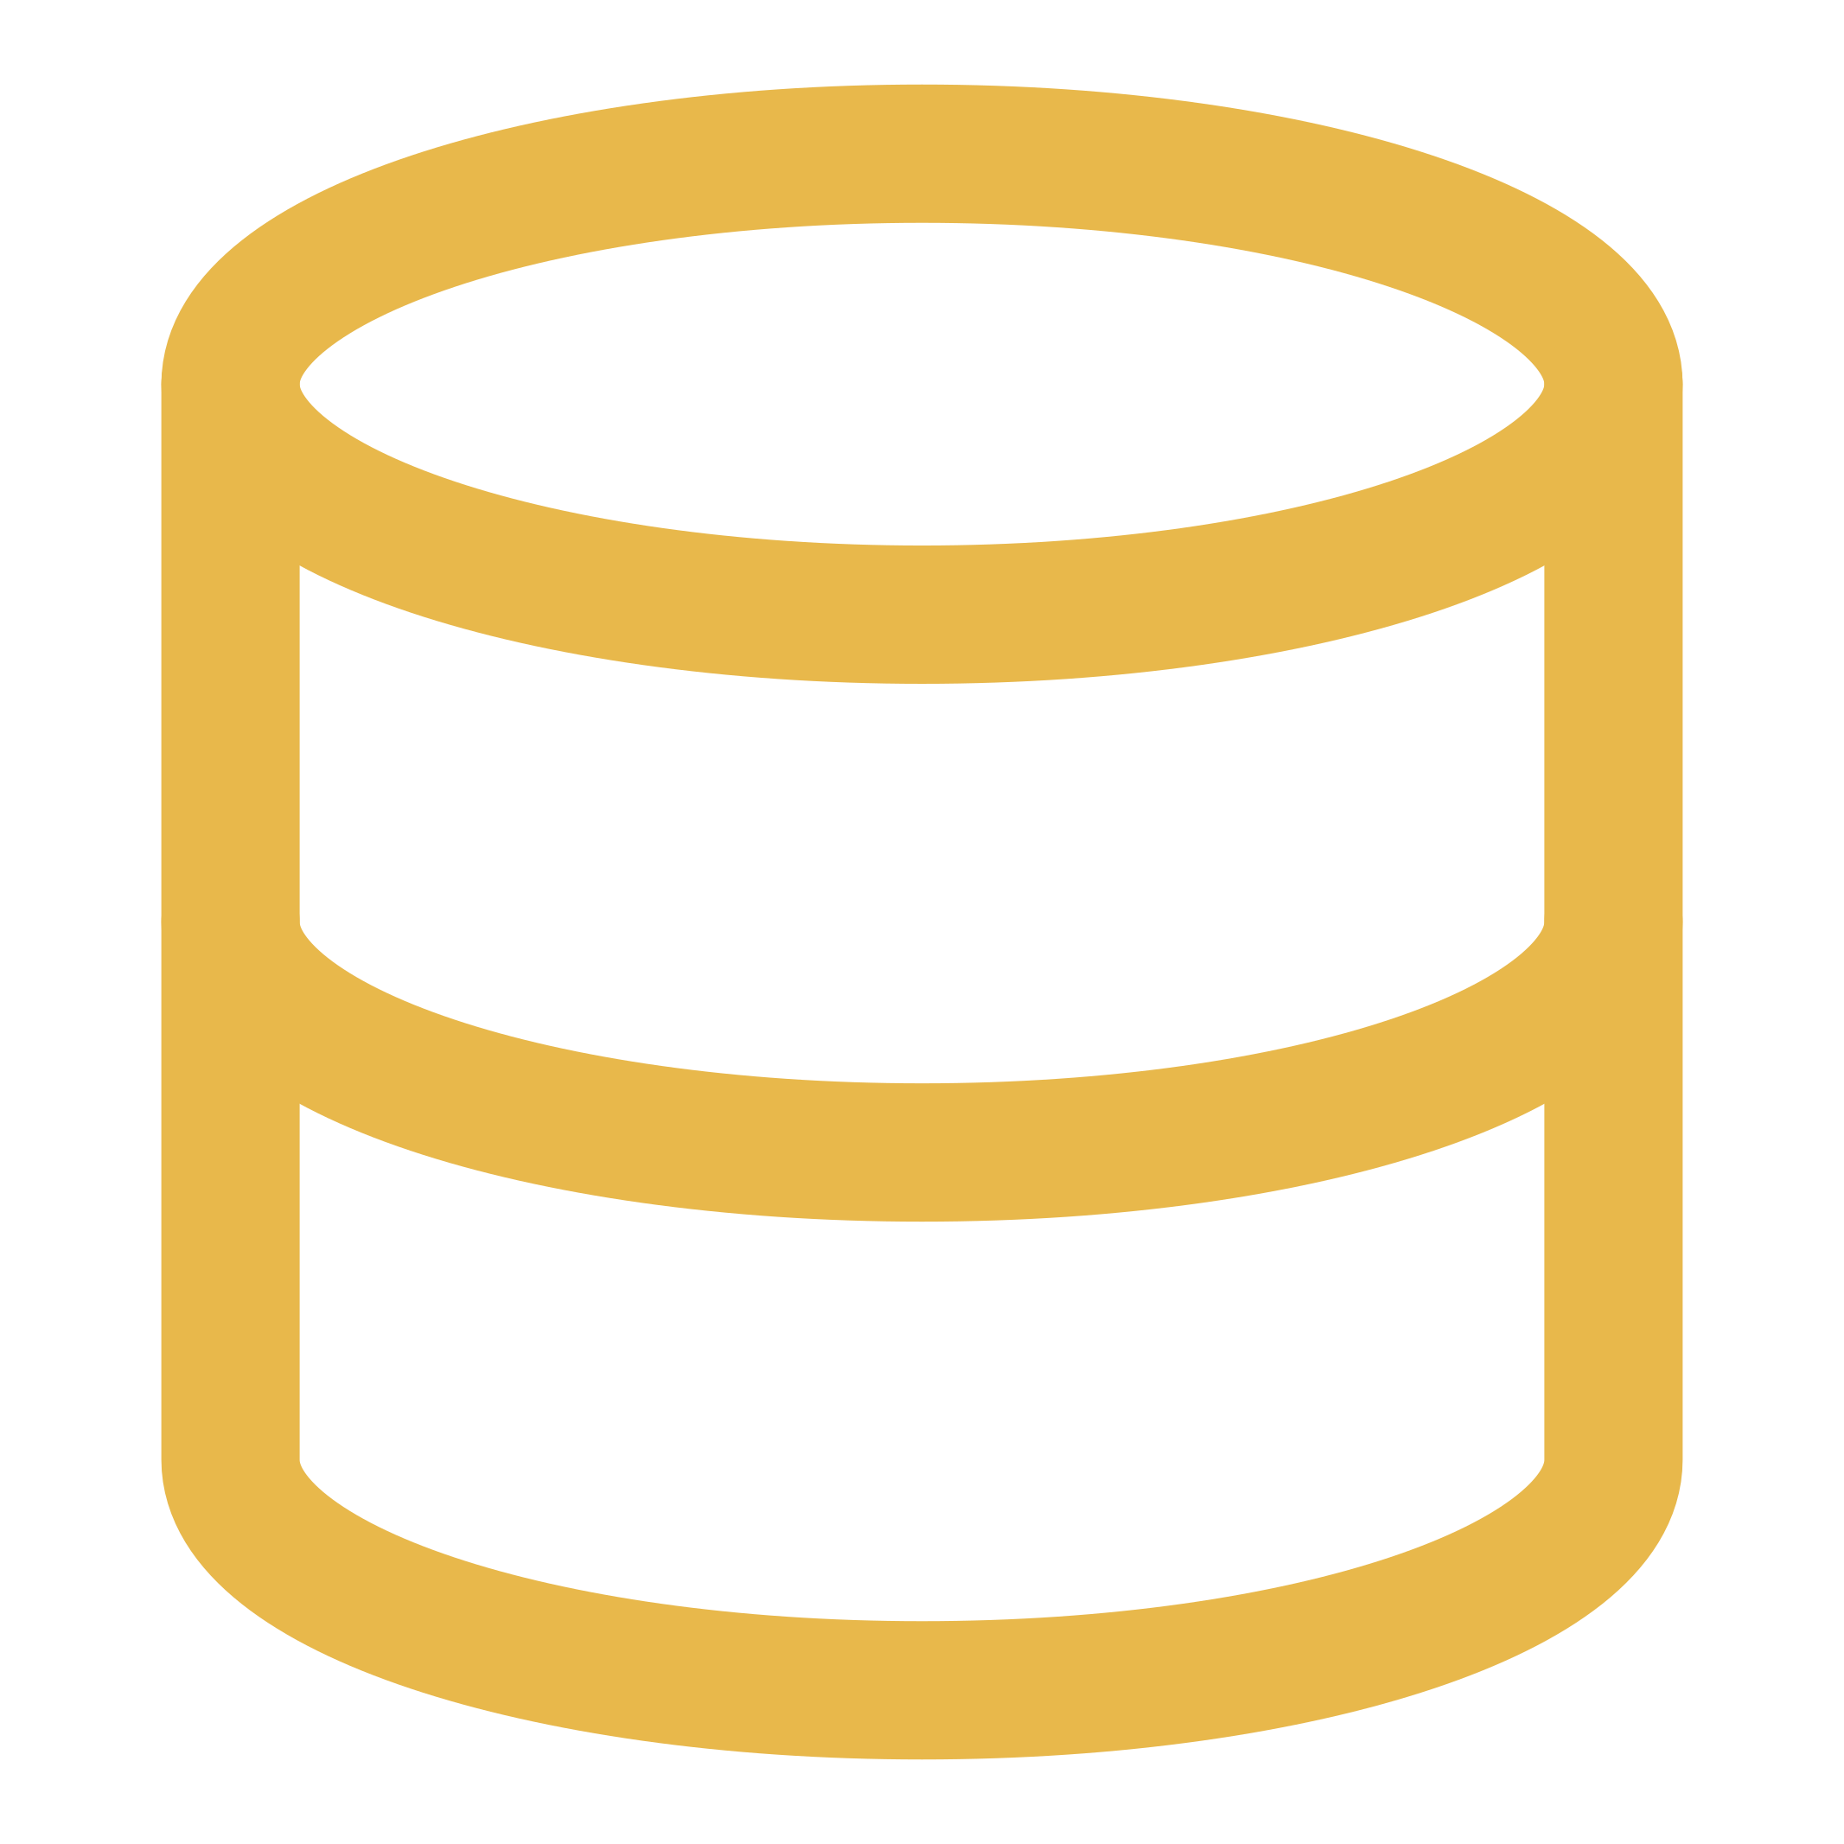


THE PROBLEM
Three failures, all expensive, none solved by another GIS licence.
The data doesn't meet
The reasoning doesn't survive
The work doesn't re-run
Magnetics, soil geochemistry, assay PDFs and imagery: getting them onto one comparable grid is senior GIS work measured in weeks.
A target is a judgement made reading several screens at once. When the geologist leaves, only the conclusion remains.
New assays land and the integration starts again: a one-off deliverable, not something you re-run on fresh data.
TERRAPULSE · MINERAL INTELLIGENCE & EXPLORATION PLATFORM
02

Slide 3



WHAT TERRAPULSE DOES
Three claims. Everything else is in service of these.
Assembly is automatic
The ranking explains itself
The output is defensible
Upload what you hold; the platform fetches the rest: imagery, terrain, magnetics, lithology and deposits, to your licence boundary.
Every target carries per-target evidence attribution: which layers pushed the score up, and by how much.
Source, checksum, processing steps and parameters recorded on every layer, built for the moment someone asks you to show your working.
TERRAPULSE · MINERAL INTELLIGENCE & EXPLORATION PLATFORM
03

Slide 4






THE PIPELINE
How it works, end to end.
One pipeline, five stages. Each stage writes provenance, so the last can always answer for the first.
1
2
3
4
5
Ingest
Augment
Normalise
Score & Rank
Explain & Export
Your survey data, validated and checksummed
Public sources fetched to your boundary
Everything on one comparable 50m grid
Weighted model scores every cell 0 to 100
Ranked targets, lineage, reports
TERRAPULSE · MINERAL INTELLIGENCE & EXPLORATION PLATFORM
04

Slide 5

SCIENTIFIC BASIS
Built on published weights, not a black box.
Weights are published, not hidden, so a geologist can disagree with a specific number.
An XGBoost surrogate plus SHAP explains every cell, decomposing a stated expert prior, not discovering geology.
Missing data scores unfavourable, not neutral. Protected areas veto rather than get down-weighted.
TERRAPULSE · MINERAL INTELLIGENCE & EXPLORATION PLATFORM
05

Slide 6




WHAT'S INSIDE
Platform at a glance.
Multi-layer map
Ranked targets
Exploration Copilot
Five basemaps; every processed layer as a toggleable overlay.
Clustered, scored 0 to 100, each with a depth-to-source estimate.
Grounded Q&A that can only cite your project's real data.
Reports & export
Data ingestion
Offline field mode
Five report types, five personas, PDF / CSV / KML / shapefile.
Geophysics, geochemistry and assay PDFs, validated and checksummed.
Targets, notes and map tiles stay usable without a connection.
TERRAPULSE · MINERAL INTELLIGENCE & EXPLORATION PLATFORM
06

Slide 7
DATA SOURCES
Built on trusted, licensed data.
Twelve integrated sources, fetched to your boundary: public data for context, your own survey data as primary evidence.
Sentinel-2
Copernicus DEM
NOAA EMAG2
Macrostrat
Alteration & vegetation
Terrain & access
Regional magnetics
Lithology favourability
OneGeology / BRGM
USGS MRDS
WDPA
OpenStreetMap
Interpretation backdrop
Known deposits
Protected-area exclusion
Roads & logistics
TERRAPULSE · MINERAL INTELLIGENCE & EXPLORATION PLATFORM
07

Slide 8

LIVE DEMO
From a licence boundary to ranked, defensible drill targets.
Let's walk through it.

